Slide 1
The Visitor Design Pattern
Jesse Snider

Slide 2
What’s It All About?
Allows for new operations to be defined and used on elements of an object structure with out changing the contents of those elements.
The Key is Double Dispatch
Notes:
Double Dispatch – The mechanism that dispatches a function call to different concrete functions depending on the runtime types of multiple objects involved in the call.
- In other words whatever object is making a function call gives another object access to that objects functions.

Slide 3
Where Applicable
Rarely Changing Object Structures
Using Unrelated Operations
Many Classes with Differing Interfaces
Notes:
Rarely Changing – The classes of the structure rarely change and always performing ops on them
Unrelated ops – When one doesn’t want to pollute their classes with unrelated operations, a visitor stucture is great for defining these operations into a visitor class.
Many Classes, Many Interfaces – when many classes have many differing interfaces and the ops one wants to use depend on the classes of those interfaces

Slide 4
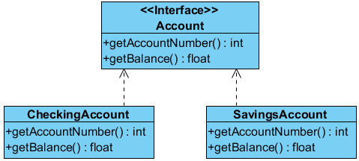
How it Works
Concrete Object Structure
Assume Rarely Changing
Bank Accounts

Slide 5
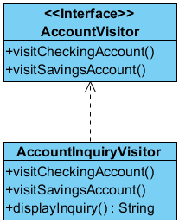
Add an Inquiry Operation
Inquiry to Display Accounts
Don’t Want to Change Structure
Create a Visitor Structure
Account Visitor

Slide 6

Account Visitor Interface
Notes:
Part of double dispatch

Slide 7
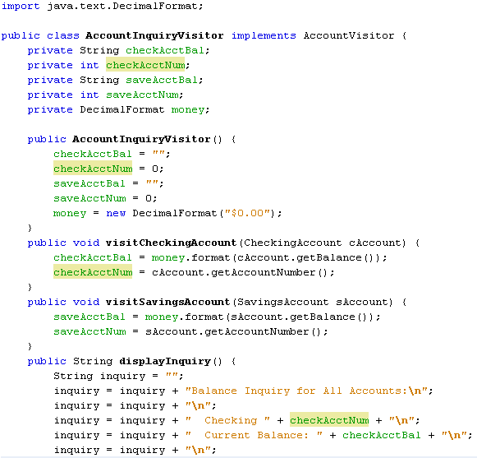
Inquiry Visitor
Notes:
Double dispatch allows for the visit methods to access account methods.

Slide 8
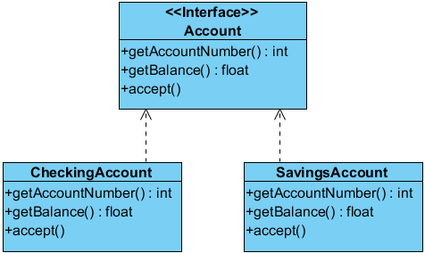
Account Structure Change

Slide 9

Account Interface

Slide 10
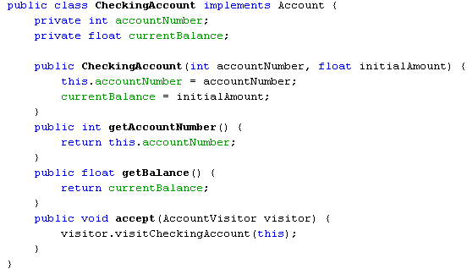
Checking Account
Notes:
Note: the accept() method here displays double dispatch. When a checkingAccount object calls the accept method with a visitor parameter it is allowing the visitor access to it’s functions.
- done by accepting the visitor and the visitor method accepting the checkingAccount object.

Slide 11
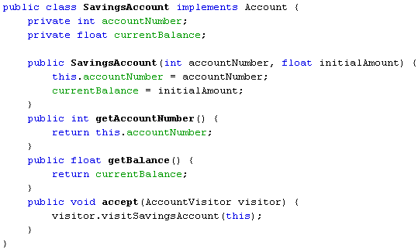
Savings Account
Notes:
Double dipatch here as well

Slide 12
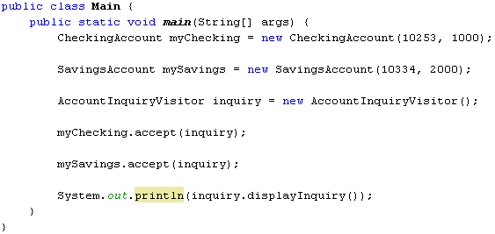
Main Method
Notes:
Both accept methods are now actually implementing the double dispatch, allowing the visitor pattern to actually work.

